Slide 1
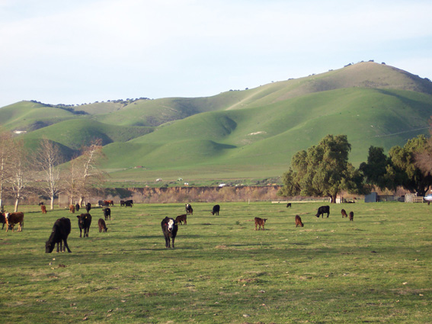
Farm animals

Slide 2

pig
dog

Slide 3
mouse
cat

Slide 4
chicken
duck

Slide 5
goat
sheep

Slide 6
horse
cow

Slide 7
What's your favourite
animal?
I like cats.

Slide 8
Do you like cats?
Yes, I do.

Slide 9
Do you like pigs?
No, I don't.

Slide 10
The End

Slide 11
Listen to the sound and guess.

Slide 13
The End

